Slide 1
History of Computers
(GR 2) Jason Nickell, George Kim, Garrett Marshall

Slide 2
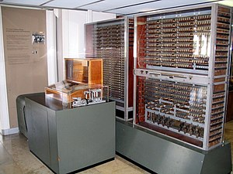
1940s The Beginning of Electromechanics
1940s started including electromechanics within their computing devices.
Z3
Average calculation speed: addition – 0.8 seconds, multiplication – 3 seconds
Data memory: 64 words with a length of 22 bits
Frequency: 5-10 Hz
Power consumption: Around 4,000 watts

Slide 3
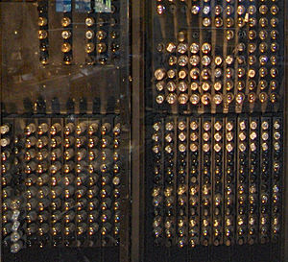
Mid 1940s- Early 1950s Transition to Electronic
There was a transition from electromechanics to electronic by invention of vacuum tubes.
ENIAC
Average calculation speed: 5,000 additions per second
Data memory: ten-digit decimal number in memory
Frequency: 100 kHz
Power consumption: 174 kilowatts

Slide 4
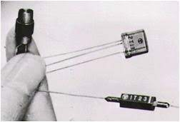
Mid 1950s-Early 1960s Transistorized Computer
vacuum tubes were slowly being replaced with discrete transistors.
Invention of magnetic core memory
Metrovick 950
Average calculation speed: 30 milliseconds per addition
Data memory: two 44-bit numbers in 1.5 drum revolutions with a drum spin rate of 3000 RPM
Frequency: 125 kHz
Power consumption: 150 watts

Slide 5
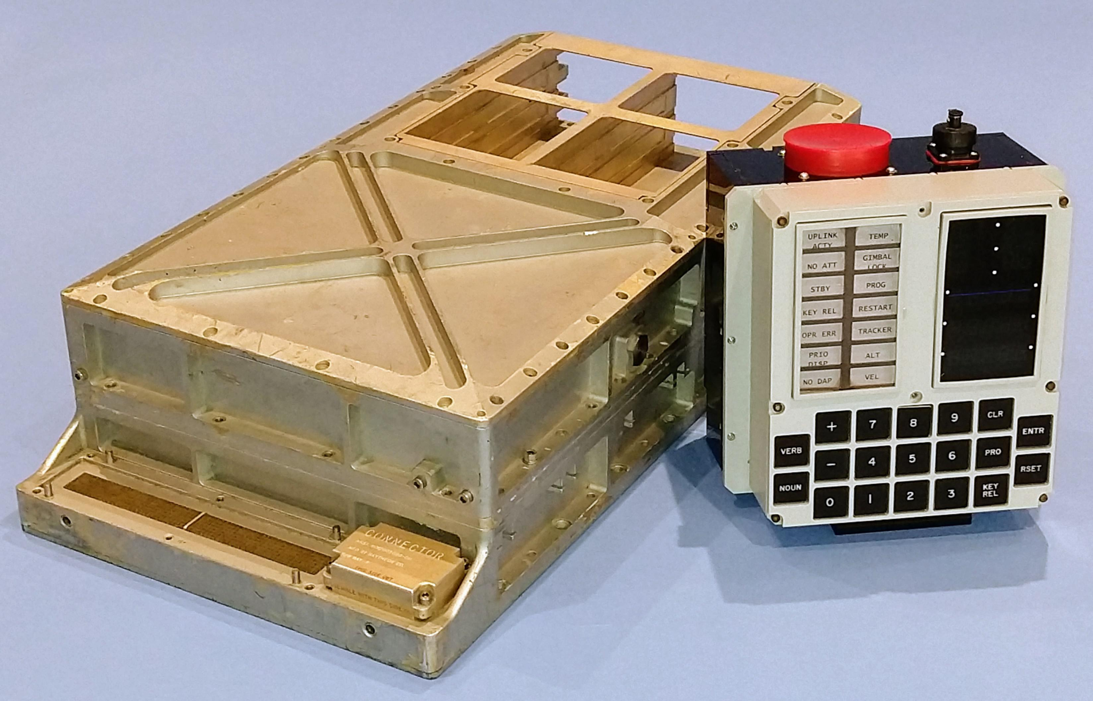
1960s Integrated Circuits
Around time period, computers started to use of integrated circuits to compacted and improves those with discrete electronic components. starting from small-scale integration CPUs to large-scale integration CPUs.
Apollo Guidance Computer
Registers: four 16-bit registers
Data memory: 2048 words RAM (magnetic-core memory), 36,864 words
Frequency: 2.048 MHz
Power consumption: 55 W

Slide 6
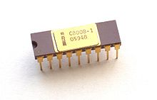
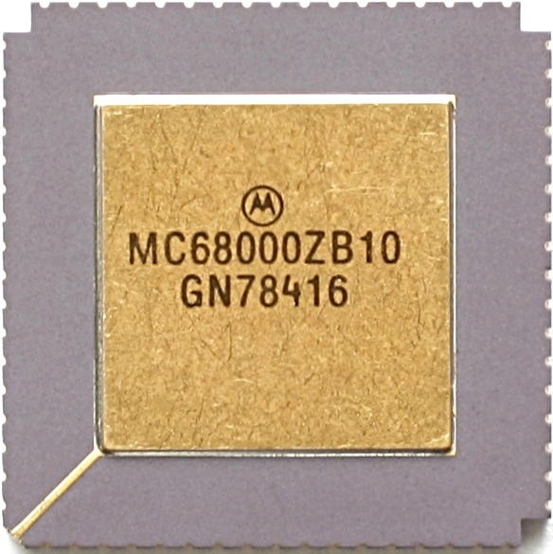
1970s Microprocessor
The 70s was a very exciting time for the transition from racks of circuit boards to a single microprocessor.
The microprocessor was introduced in 1969, but was a bit lackluster and not very powerful.
The first “true” microprocessor was the intel 8008 released on the market by intel in 1971, and an improved version, the 8080, was released in 1874.
The most powerful microprocessor released in the 70s was the Motorola 68000.

Slide 7
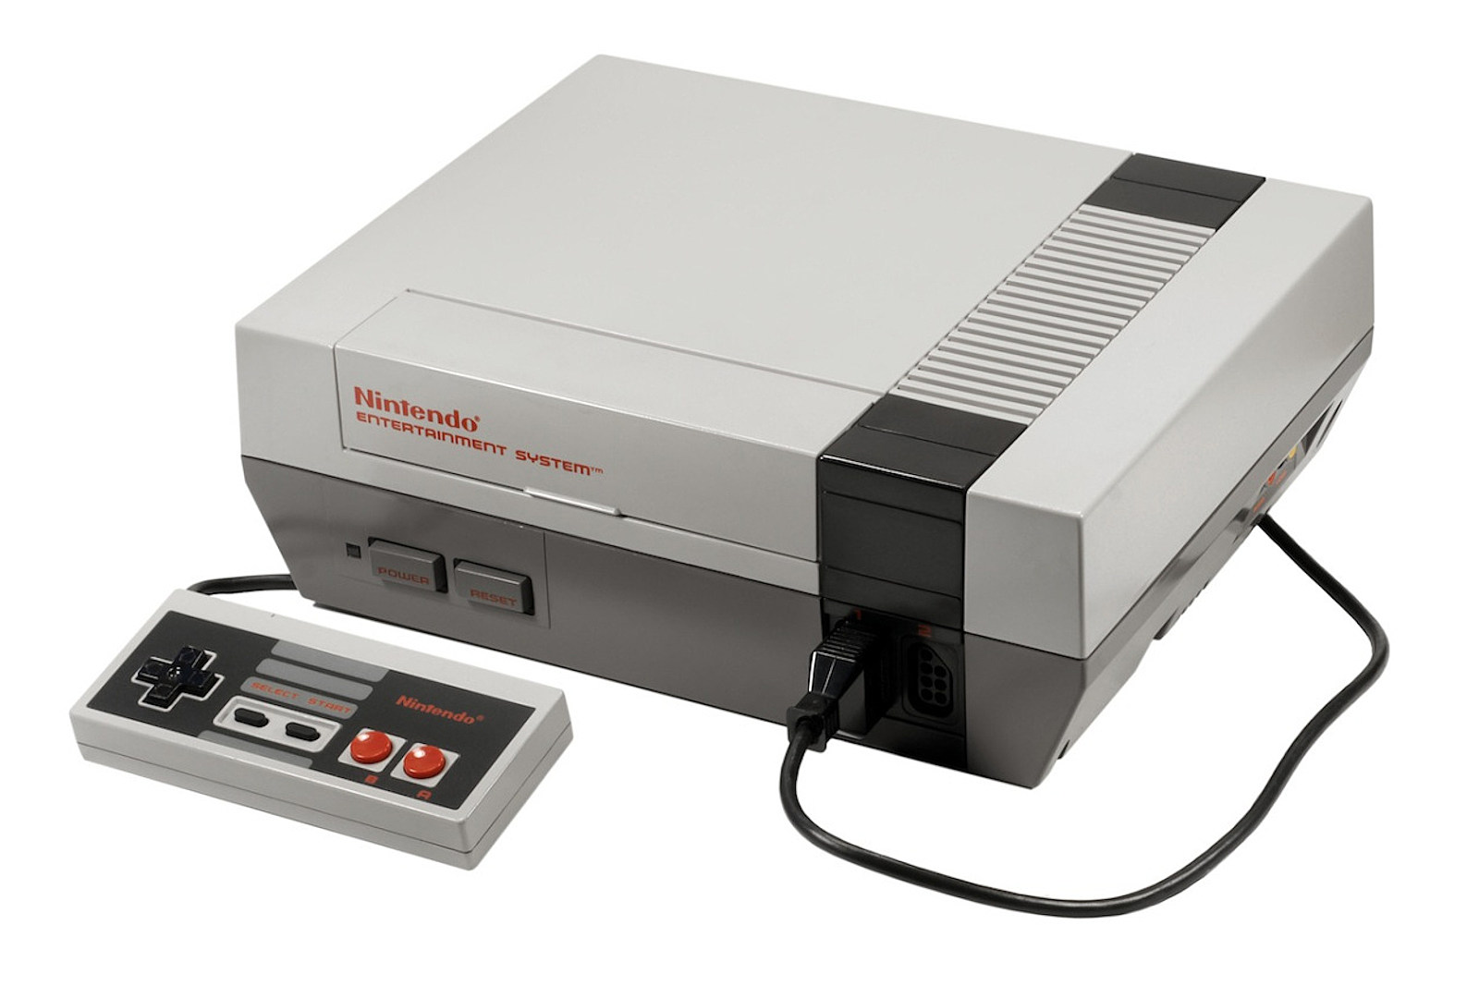
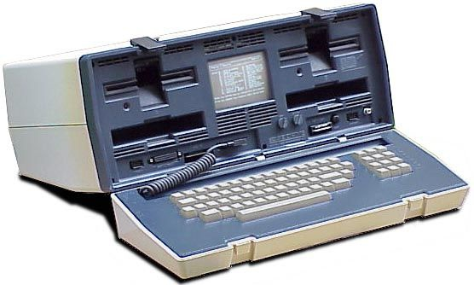
1980s: Affordable Computing
Early 80s computers utilized a 8-bit cpu architecture eventually moving to a 16-bit.
Typical specs of the 80s included:
1 - 4 mhz cpu speeds.
Keyboard and monitor connected directly to the motherboard.
A combination of different kinds of RAM (Static and Dynamic).
Cassette tape storage until replaced with 5.1” floppy disks.
At the end of the 80s when GUI’s were more popular mice started being used.
Notes:
During the 1980’s the computer world started to boom, not just in the effectiveness of hardware, but in how people perceived computers.
Previously, computers were thought of as giant machines that were used by scientists to process data and do mathematics.
Then much smaller cheaper computers started rolling out allowing people to experience them in their own homes.
(talk about slide stuff briefly)

Slide 8
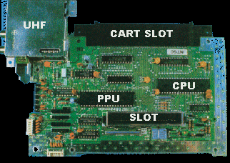
The King of Entertainment Systems
The Nintendo Entertainment System (NES) was released in 1983.
Hardware consisted of
8-bit 1.79 MHz processor.
Resolution output of 256x224.
2 KB RAM.
Integrated Picture Processing Unit (PPU).
Game cartridges could boost the systems performance
Contained additional RAM
Other chips were built in to increase other capabilities like sound and graphics.
Notes:
There were a few distinctive types of computers that existed in the 80s. Bulky laptops started to emerge, bigger and better supercomputers, personal computers, and of course game systems. While there were many different game systems rolling out like the Atari, the NES became the one to rule them all. Its specs included an 8-bit 1.79 MHz processor with a resolution of 256x224. It also had 2 KB of RAM. The custom PPU that was integrated on the motherboard handled the display and processing of the game graphics. Perhaps the most interesting thing about the system was that the individual game cartridges could contain additional integrated chips and memory to enhance the systems performance.

Slide 9
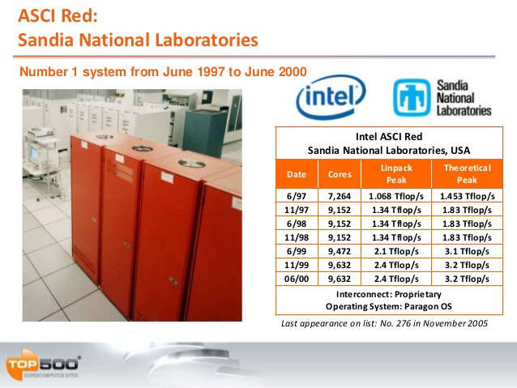
ASCI Red
First supercomputer to reach teraflop speeds.
4 separate partitions.
Compute.
Service.
I/O.
System.
Specs:
104 cabinets taking up 1600 square feet.
1212 GB of RAM.
7264 Intel Pentium Pro processors clocked at 200 MHz.
Required 850 KW of power not including A/C.
12.5 terabytes of disk storage.
Notes:
One of the greatest achievements of the 90s was the ASCI Red. The first computer that was created under the accelerated strategic computing initiative or ASCI. This computer was designed and used to help maintain the and test nuclear materials for the United States.
The computer was structured into 4 partitions: computing, service, I/O, and system. The computer did not support global shared memory so each node had its own memory and then data would be shared through an explicit message-passing method.
This supercomputer was the first computer to hit teraflop speeds. A teraflop is a measurement of the cpu’s calculations per ser second. So it would equate to 1 trillion floating-point calculations per second. This is insane considering the previous fastest supercomputer only had 232 gigaflops or around 232 billion calculations per second.
This was achieved utilizing a lot of hardware. The entire supercomputer was housed in 104 cabinets that took up 1600 square feet. Within these cabinets there was 7264 intel Pentium pro processors clocked at 200 MHz. 1212 GB of RAM. 12.5 terabytes of disk storage. Without air conditioning the entire computer required 850 kila watts of power. To put it in perspective an average computer probably uses around 250 watts of power; this thing used 850,000 watts.

Slide 10


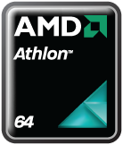
Modern Day Problems
Compared to the early years of computing and advancements in the field, the 2000s onwards have been pretty dull. Nevertheless, there are still some important developments to highlight.
Popularization of Wi-Fi and eventually Bluetooth
First 64 bit processors (AMD Athlon 64)
The fight for domains and popularization of the internet.

Slide 11
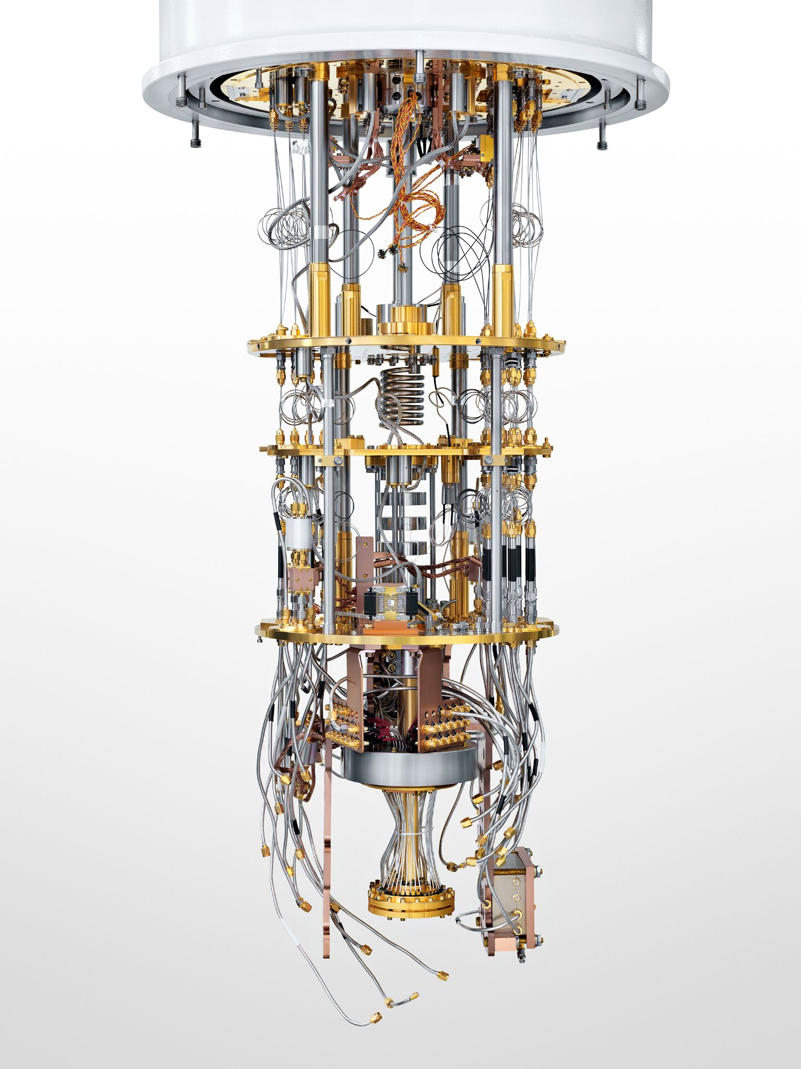
Final Note: Quantum Computing
Quantum computing is a subject that is still being explored and expanded on by the humans of today. The basis of it is that it uses quantum phenomena to perform computations at a rate that we have never seen.
We currently have no universal quantum machine that can perform a variety of computational tasks. It is said that in terms of computational ability a quantum computer can do the same tasks that a normal computer does and vice versa.

